Slide 1
Bookstore Application
Michael Mengistu
Project 1

Slide 2
Overview
This bookstore application is a Python-based command-line program that allows users to interact with a digital bookstore.
It leverages a MySQL database for data storage and retrieval.
Application provides a complete set of CRUD (Create, Read, Update, Delete) operations for managing books, users, and orders.
Uses AWS to host the database.

Slide 3
Features
User Features:
Sign up and log in.
Browse the list of available books.
Purchase a book (each order would be a separate record in the Orders table).
View their own order history.
Admin Features:
Manage users (view/edit/remove).
Manage books (add/edit/remove).
View all orders.
Security Features:
application protects user accounts by hashing there passwords.

Slide 4
Database Design
The application uses three tables:
1. Users: Stores user account details
2. Books: Manages book inventory
3. Orders: Records user purchases and order details

Slide 5
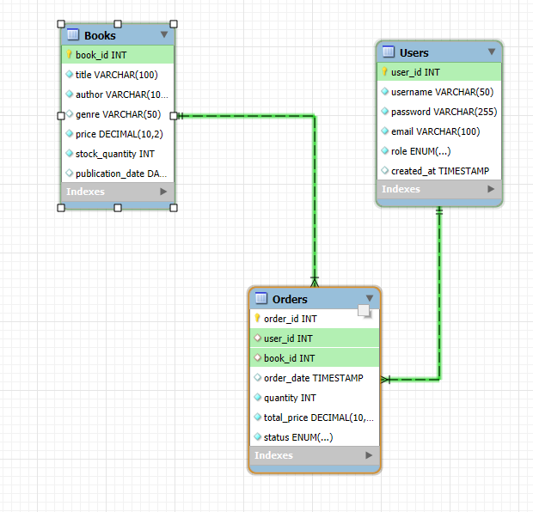
Entity-Relationship Diagram (ERD)
Users (1-to-many) Orders:
A user can place multiple orders, but each order belongs to one user.
Books (1-to-many) Orders:
A book can be part of multiple orders, and each order can only contain one book in this simplified model.

Slide 6
User Interface
Command-Line Interface (CLI):
Main Menu:
Sign Up
Log In
Exit
User Menu:
View Books
Purchase
View Orders
Log Out
Admin Menu:
Manage Books
Users
Log Out

Slide 7
Tech Stack:
Python 3.x (3.12.6)
VS Code
MySQL
Git

Slide 8
Future Improvements
Implement a graphical user interface (GUI)
Add support for more payment options
Implement a recommendation system for books

